Slide 1
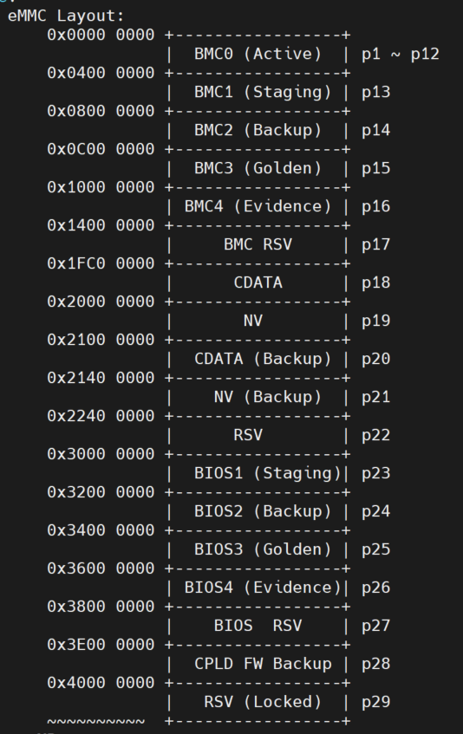
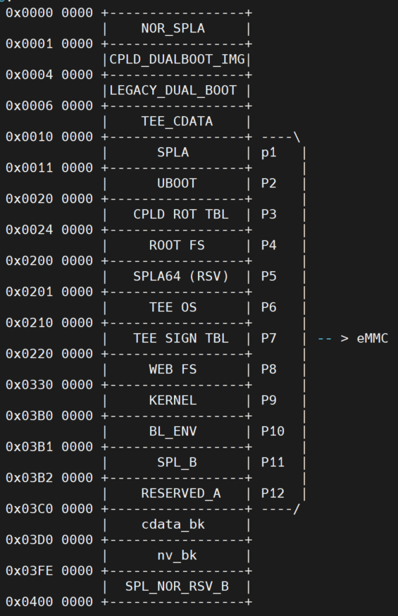
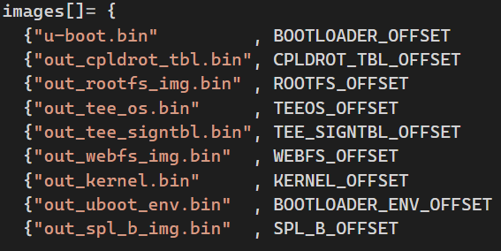

Slide 2
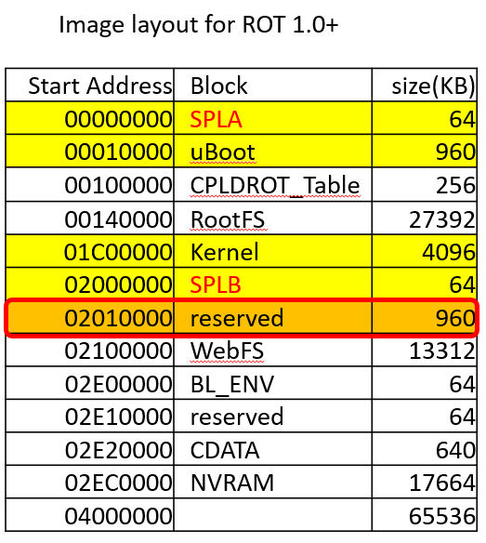
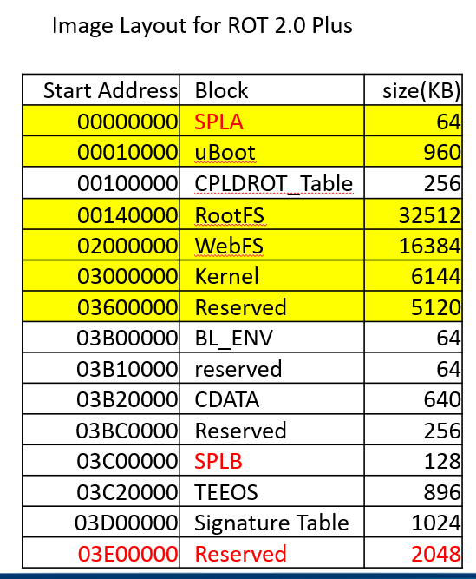

Slide 3
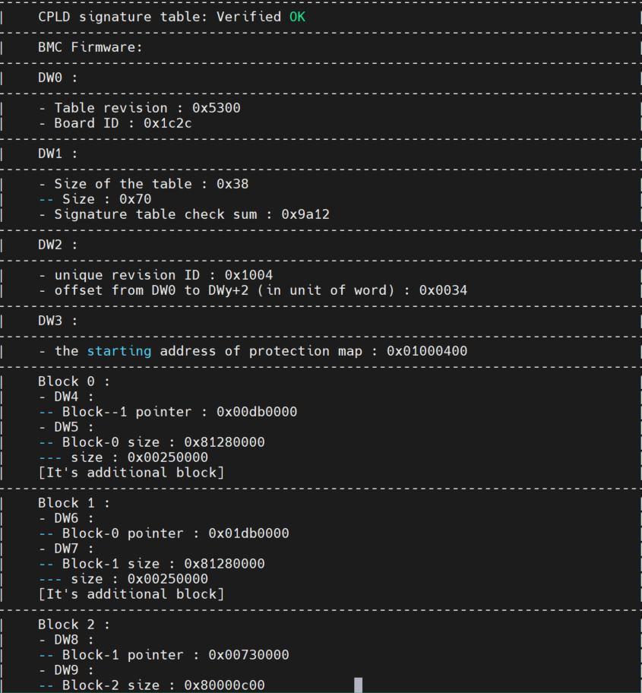
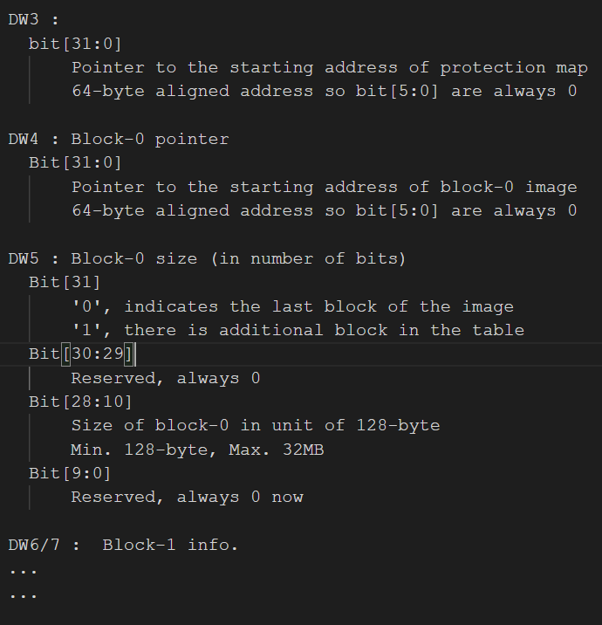
http://10.135.174.189/PaulLi/fwimg_parser
Fwimg_parse –f image –t 1

Slide 4
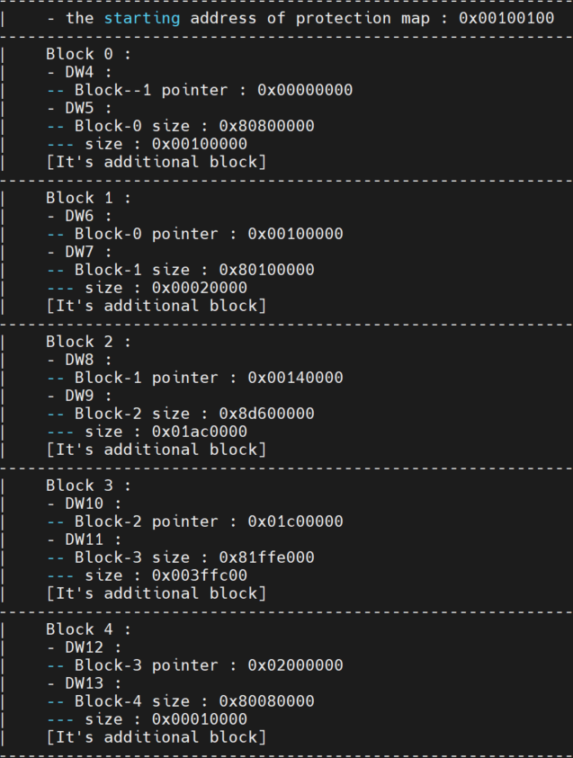
Block 0
0000 0000 SPLA
0010 0000 size
0010 0000
Block 1
0010 0000 ROT
0002 0000 size
0012 0000 half rot table
Block 2
0014 0000 RFS
01AC 0000 size
01C0 0000 all rootFS
Block 3
01C0 0000 KNL
003F FC00 size
01FF FC00 almost all kernel
Block 4
0200 0000 SPLB
0001 0000 size
0201 0000 all splb

Slide 5
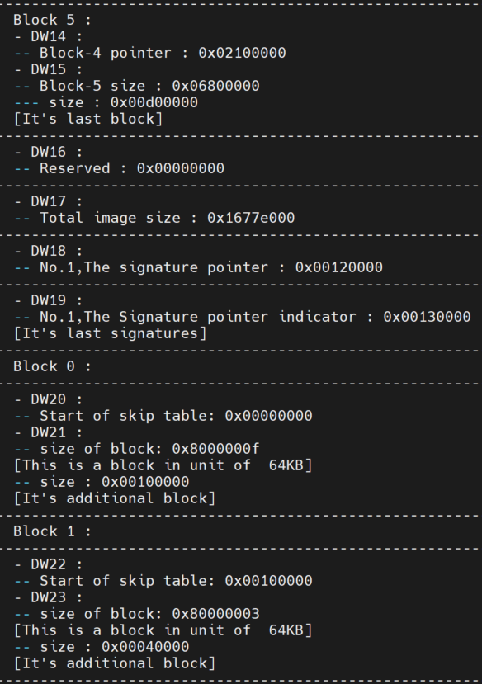
Block 5
0210 0000 WebFS
00d0 0000 size
02e0 0000 all webfs
--- Last Block ---
Block 0 - skip table -
0000 0000 SPLA
0010 0000 size
0010 0000 all spla
Block 1- skip table -
0010 0000 ROT
0004 0000 size
0014 0000 all rot table

Slide 6
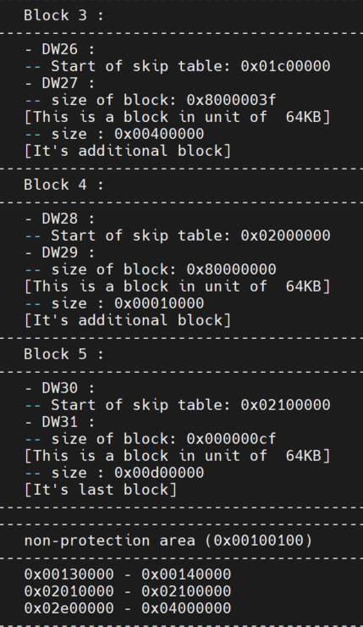
Block 3 - skip table -
01C0 0000 KNL
0040 0000 size
0200 0000 all kernel
Block 4 - skip table -
0200 0000 SPLB
0001 0000 size
0201 0000 all splb
Block 5 - skip table -
0210 0000 WebFS
00D0 0000 size
02E0 0000 all webfs
-------------------------
Non-protection
------------------------
0013 0000 – 0014 0000 part of rot tbl
0201 0000 – 0210 0000 reserved
02e0 0000 – 0400 0000 bl_env ~ end

Slide 7
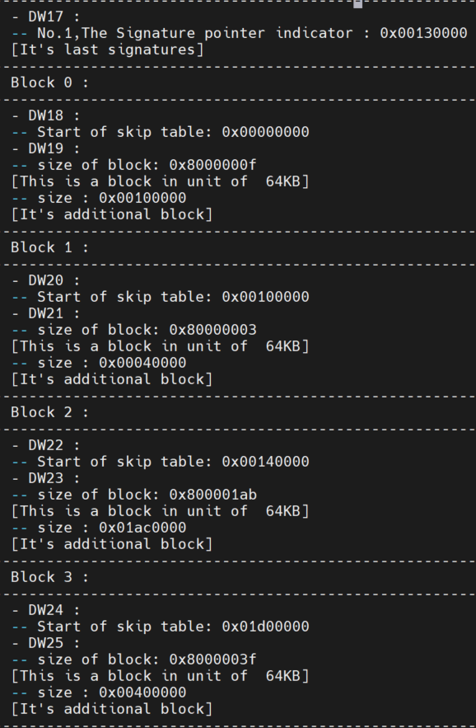
Purpose of“copy-skip-table”is to preserve dynamic data of the current version during firmware updates.

Slide 8
x12/Project_File/AST2600/flash_layout_rot2p_with_spl_64M.config
BOOTLOADER_OFFSET 0x00000000
CPLDROT_TBL_OFFSET 0x00100000
ROOTFS_OFFSET 0x00140000
TEEOS_OFFSET 0x01F10000
TEE_SIGNTBL_OFFSET 0x02000000
WEBFS_OFFSET 0x02100000
KERNEL_OFFSET 0x03200000
SPL_B_OFFSET 0x03A00000
x12/Project_File/AST2600/flash_layout_rot_with_spl_64M.config
BOOTLOADER_OFFSET 0x00000000
CPLDROT_TBL_OFFSET 0x00100000
ROOTFS_OFFSET 0x00140000
KERNEL_OFFSET 0x01C00000
SPL_B_OFFSET 0x02000000
WEBFS_OFFSET 0x02100000

Slide 9
(0) DW0000:53 00 01 00
(1) DW0004:00 40 ae c1
(2) DW0008:00 01 00 28
(3) DW000c:00 10 01 00
(4) DW0010:00 00 00 00
DW0014:80 80 00 00
DW0018:00 10 00 00
DW001c:80 10 00 00
DW0 : Table revision
bit[31:16] 5300h
bit[15:0] Board ID
DW1 : Signature table check sum
bit[23:16] Size of the table 40
bit[15:0] 16-bit arithmic sum ae c1
DW2 :
bit[31:16] 16-bit, non-0000/FFFFh, unique revision ID 00 01
bit[15:0] Offset from the starting address of DW0 to the starting address of
skip table (DWy+2), in unit of word (16-bit data) 00 28
last_block_offset = (bswap_32(*(pDW+2))&0xFFFF) *2 => 0x28 * 2 = 0x50 bytes
while(DW_count < last_block_offset/4) => DW_count < 0x50 / 4 = 80/4 = 20 ??
DW3 :
bit[31:0] Pointer to the starting addr of protection map 00 10 01 00
DW4 : Block-0 pointer
Bit[31:0] Pointer to the starting address of block-0 image 00 00 00 00
DW5 : Block-0 size (in number of bits) 80 80 00 00
Bit[31] '1', there is additional block in the table 1

Slide 10
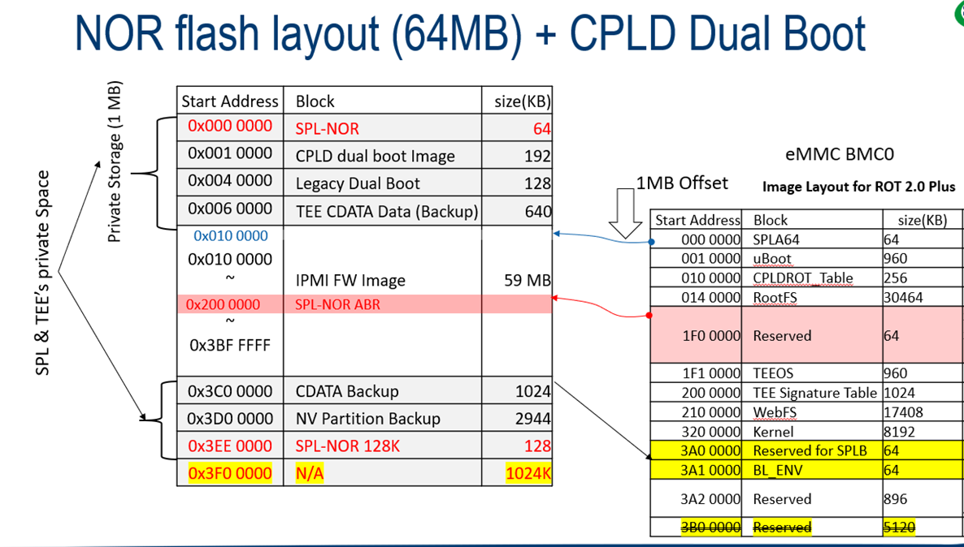
When parsing X13 fw image, need to config offset as following:
CPLDROT_Table Start Address: 020 0000 since 1MB Offset
BMC_CPLD_SIGNATURE_OFFSET 0x00220000 changed too.

Slide 11
sha_all = EVP_MD_CTX_create())
EVP_DigestInit_ex(sha_all, EVP_sha512(), NULL))
#ifdef CPLD_ROT2HW2_FEATURE
EVP_DigestUpdate(sha_all, (tmpBuf + BOOTLOADER_OFFSET), BOOTLOADER_SIZE)) 0x00000000 , 0x00100000
EVP_DigestUpdate(sha_all, (tmpBuf + CPLDROT_TBL_OFFSET), CPLDROT_SIGN_OFFSET - CPLDROT_TBL_OFFSET))
0x00100000 , 0x00020000 (= 0x00120000 - 0x00100000)
EVP_DigestUpdate(sha_all,(tmpBuf + ROOTFS_OFFSET), ROOTFS_SIZE)) 0x00140000 , 0x01DC0000
EVP_DigestUpdate(sha_all,(tmpBuf + TEEOS_OFFSET), TEEOS_SIZE)) 0x01F10000 , 0x000f0000
EVP_DigestUpdate(sha_all,(tmpBuf + TEE_SIGNTBL_OFFSET), TEE_SIGNTBL_SIZE)) 0x02000000 , 0x00100000
EVP_DigestUpdate(sha_all,(tmpBuf + WEBFS_OFFSET), WEBFS_SIZE)) 0x02100000 , 0x00D00000
EVP_DigestUpdate(sha_all,(tmpBuf + KERNEL_OFFSET) , KERNEL_SIZE - PAGE_SIZE_NVM + SIGA_OFFSET)
0x03200000 , 0x007ffc00 (= 0x00800000 - ? + ?? )
EVP_DigestUpdate(sha_all, (tmpBuf + SPL_B_OFFSET), SPL_B_SIZE)) 0x03A00000 , 0x00010000
digest_all = (unsigned char *)OPENSSL_malloc(EVP_MD_size(EVP_sha512()))) == NULL)
1 == RSA_verify(NID_sha512, digest_all, SHA512_DIGEST_LENGTH, signall_enc, BMC_SIGN_SIZE, *rsa))
RSA verify OK

Slide 12
#else // Normal
EVP_DigestUpdate(sha_all, (tmpBuf + BOOTLOADER_OFFSET), BOOTLOADER_SIZE))
EVP_DigestUpdate (sha_all, (tmpBuf + CPLDROT_TBL_OFFSET), CPLDROT_SIGN_OFFSET-CPLDROT_TBL_OFFSET)
EVP_DigestUpdate(sha_all,(tmpBuf + ROOTFS_OFFSET), ROOTFS_SIZE))
EVP_DigestUpdate(sha_all,(tmpBuf + KERNEL_OFFSET) , KERNEL_SIZE - PAGE_SIZE_NVM + SIGA_OFFSET))
EVP_DigestUpdate(sha_all,(tmpBuf + SPL_B_OFFSET), SPL_B_SIZE))
EVP_DigestUpdate(sha_all,(tmpBuf + WEBFS_OFFSET), webs_size))
Fwimg parsing BMCH12SSG Rot1plus image
0x00000000 0x00100000
0x00100000 0x00020000
0x00140000 0x01ac0000
0x01c00000 0x003ffc00
0x02000000 0x00010000
0x02100000 0x00d00000
Signbin_extrac.c
BOOTLOADER_OFFSET= 0x00000000 BOOTLOADER_SIZE= 0x00100000
CPLDROT_TBL_OFFSET= 0x00100000 CPLDROT_SIGN_OFFSET - CPLDROT_TBL_OFFSET= 0x00020000
ROOTFS_OFFSET= 0x00140000 ROOTFS_SIZE= 0x01AC0000
KERNEL_OFFSET= 0x01C00000 KERNEL_SIZE - PAGE_SIZE_NVM + SIGA_OFFSET= 0x3FFC00
SPL_B_OFFSET= 0x02000000 SPL_B_SIZE= 0x00010000
WEBFS_OFFSET= 0x02100000 WEBFS_SIZE = 0x00D00000

Slide 13
// print from UpdateMode.c
BOOTLOADER_OFFSET =0x00000000, BOOTLOADER_SIZE =0x00100000
CPLDROT_TBL_OFFSET =0x00100000, CPLDROT_SIGN_OFFSET-CPLDROT_TBL_OFFSET =0x00020000
ROOTFS_OFFSET =0x00140000, ROOTFS_SIZE =0x01dc0000
TEEOS_OFFSET =0x01f10000, TEEOS_SIZE =0x000f0000
TEE_SIGNTBL_OFFSET =0x02000000, TEE_SIGNTBL_SIZE =0x00100000
WEBFS_OFFSET =0x02100000, WEBFS_SIZE =0x00d00000
KERNEL_OFFSET =0x03200000, KERNEL_SIZE - PAGE_SIZE_NVM + SIGA_OFFSET =0x007ffc00
SPL_B_OFFSET =0x03a00000, SPL_B_SIZE =0x00010000

